Slide 1
AR information 2019 Wednesday 6th November

Slide 3
STAR tests completed in September 2019
34 questions that are to be completed in 20 minutes (average completion time)
From this, a pupil is given a reading range, individual to each pupil
From this score, AR calculates a realistic total of points the pupil would be able to ‘earn’ if they were to read for 20 minutes per day, within their reading range
At the end of the term, another STAR test will be completed. If the pupil has been reading regularly, passing quizzes at above 80%- the pupil will have a more challenging reading range for the following term

Slide 5
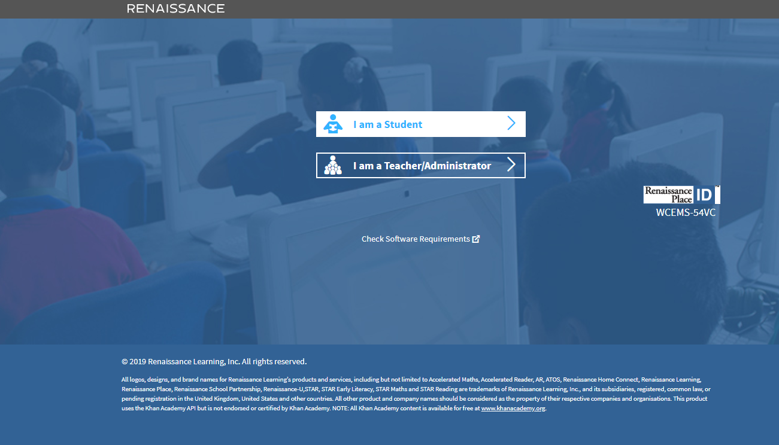

Slide 7
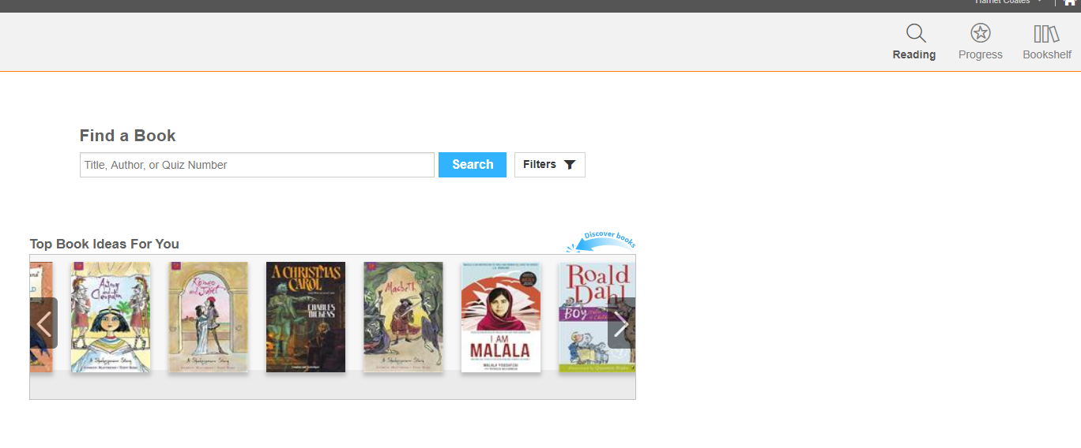

Slide 8
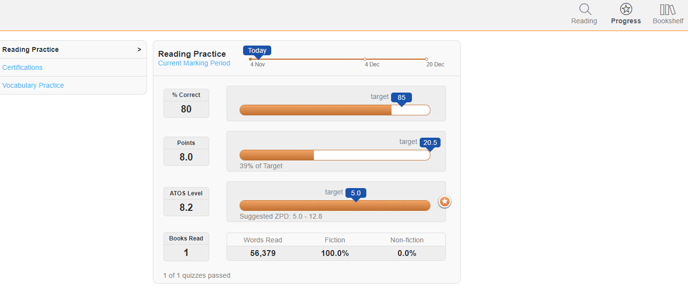

Slide 9
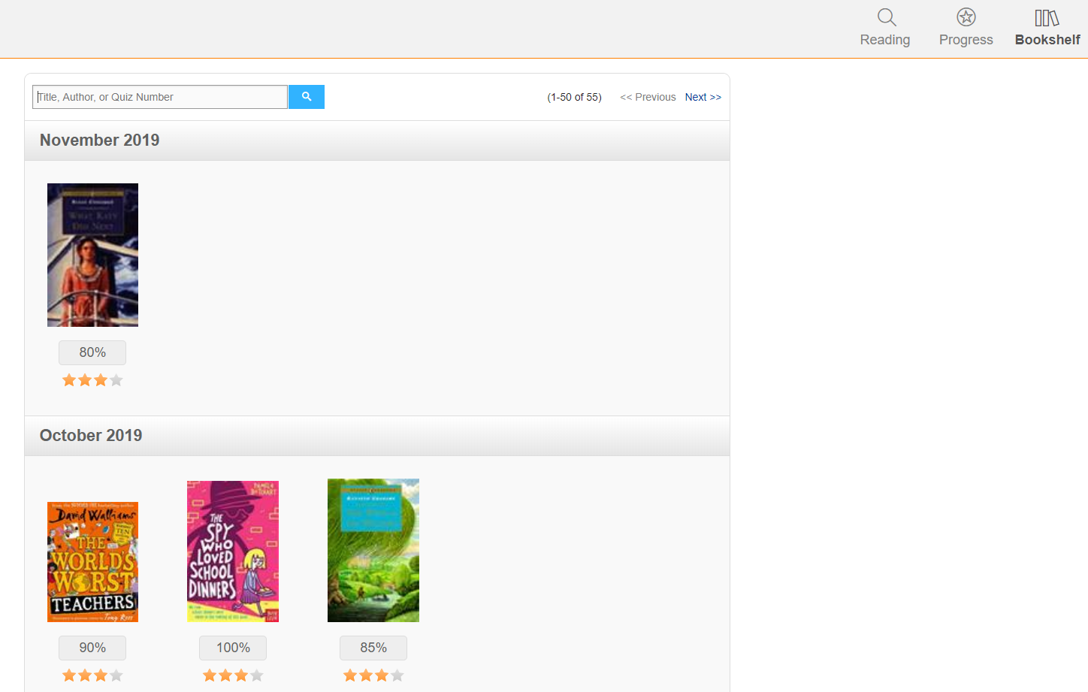

Slide 10
If one reads daily (in accordance with the above) from Year 5 to the end of Year 11, Student A will have read for the equivalent of 60 school days, Student B will have read for 12 school days and Student C will have read for 3!
Do you fit into the Student A, B or C category?

Slide 12
